Slide 1
A Look Under The Hood The fastest, in-memory analytic database in the world
Dan Andrei STEFAN
www.rentadba.eu
05.05.2017

Slide 2
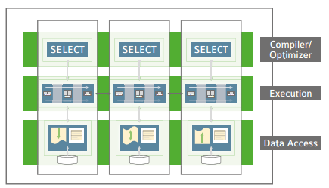
What is Exasol?
Developers’s
founded in 2000, in Nuremberg, Germany
high-performance, in-memory, MPP database specifically designed for in-memory analytics.
since 2008 leads the TPC-H (decision support) for 100G to 100TB
ANSI SQL Compliance (SQL 2008)
ACID / transaction support
locking at the entire database object level
integration with R, Python, Java and LUA using UDF scripts
driver for ODBC, JDBC and ADO.NET
JSON over WebSockets API
Client SDK / Exasol CLI – native C++
DBA’s
Single node or clustered using ExaOperation
Tables horizontally distributed (or fully replicated)
Columnar compression
SPMD (single program / multiple data): SQL made available to all nodes in cluster, local execution graph (plan) is generated and all nodes execute in parallel
parser is called SQL compiler: execution graphs
optimizer applies both rule and cost based optimization models
Optimizer may create indexes on the fly

Slide 3
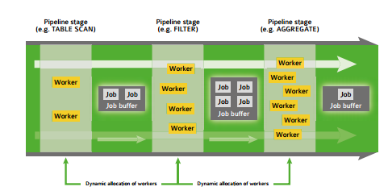
A look under the hood
Developers’s
Free small business edition VM available for download: limited to max 200 GB of memory
How to use it
Code is similar with PostgreSQL or Oracle
OPEN SCHEMA optymyze;
CREATE OR REPLACE TABLE T
(
)
DISTRIBUTE BY column;
IMPORT INTO T
FROM LOCAL CSV FILE ''
COLUMN SEPARATOR = 'TAB' SKIP = 0
ROW SEPARATOR = 'CRLF' ;
select sum(y) from T where x>5;
Lots of system dictionaries tables
EXA_DBA_USERS
EXA_DBA_OBJECTS
EXA_DBA_OBJECT_SIZES
EXA_MONITOR_HOURLY / DAILY / MONTHLY
DBA’s
Pipeline system execution: job, job buffer, worker – across nodes
Data is being referred, not copied or moved in intermediate jobs
in RAM are kept only used columns
Memory: dictionary based methods compression
Disk: block based compression
EXAStorage layer: classify data as hot, warm or cold
with the database, in-memory does not mean that the system is limited by the available main memory. Instead it means that its algorithms are designed under the assumption that data will usually be in memory or even in CPU cache by the time it is being used.

Slide 4
Q & A

