Slide 1
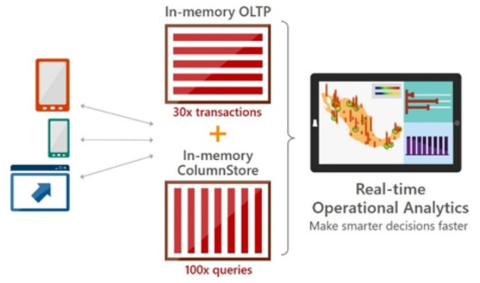
In-Memory Capabilities
Dan Andrei STEFAN
www.rentadba.eu
https://github.com/rentadba/dbaTDPMon
05.05.2017

Slide 2
In-Memory OLTP
Developers’s
Started in 2007 as Project Verde -> released as Hekaton / In Memory OLTP in SQL Server 2014
How to use it
Create a Memory Optimized filegroup (yes, it does have file(s) on disk! )
ALTER DATABASE [db_name] ADD FILEGROUP [fg_name] CONTAINS MEMORY_OPTIMIZED_DATA
ALTER DATABASE [db_name] ADD FILE (name=‘logical_name', filename=‘physical_file_name') TO FILEGROUP [fg_name]
Create a Memory Optimized table (rowstore !)
CREATE TABLE [in-memory-oltp-table] ([..]) WITH (MEMORY_OPTIMIZED = ON, DURABILITY = SCHEMA_AND_DATA);
Durability
SCHEMA_AND_DATA:
level of data durability depends on transaction - full or delayed durability
SCHEMA_ONLY
Decide on index strategy
HASH: unique row lookups
pay attention to Bucket_Count parameter
Non-Clustered: range lookups (Bw-tree implementation)
Fully ACID
Isolation levels: Snapshot / Repeatable Read / Serializable
T-SQL support
some restriction applies: eg: foreign keys, truncate table
DBA’s
Allocation & Storage
Rows are stored as “heaps”: header (max 86 bytes) + payload (the row itself)
Index is the only connection between distinct rows
Hash indexes: one deterministic function for all / array of pointers
NC index page pointer is a position in a mapping table (physical memory address)
Durability
No WAL protocol
Logs generated at commit time / grouped in records up to 24 kb
Data file(s): inserted versions of rows
Delta file(s): deleted versions or rows
Automatic/manual merge of data and delta files
Multi-Version Optimistic Concurrency (MVCC)
Rows never change: UPDATE = DELETE + INSERT
Row versions (not in tempdb)
Optimistic approach: in case of a conflict (eg. concurrent updates – same row same time), fail one transaction
Starting SQL Server 2016 there is no limit on the size of memory-optimized tables, other than available memory.
Supported in Always on Availability Groups / Azure SQL Database
Usage scenarios
High-throughput and low-latency transaction processing (eg. BWIN, 1.2 million batch requests / sec)
Caching
ETL staging tables
Replacement for tempdb

Slide 3
Native Compilation
Developers’s
Takes the table and stored procedures definitions as input, generates C code, and leverages the Visual C compiler to generate the native code.
The result of the compilation of tables and stored procedures are DLLs that are loaded in memory and linked into the SQL Server process.
How to use it
Create a stored procedure and mark with NATIVE_COMPILATION
CREATE PROCEDURE dbo.[usp_native_compiled]
WITH NATIVE_COMPILATION, SCHEMABINDING, EXECUTE AS OWNER
AS
BEGIN ATOMIC
WITH (TRANSACTION ISOLATION LEVEL=snapshot, LANGUAGE=N'us_english')
INSERT dbo.[in-memory-oltp-table] VALUES ([...])
END
GO
Compilation and Query Processing
DBA’s
The information necessary to recreate the DLLs is stored in the database metadata; the DLLs themselves are not part of the database.
the DLLs are not part of database backups.
not need to maintain the files that are generated by native compilation. SQL Server automatically removes generated files that are no longer needed (on table and stored procedure deletion, on drop database and also on server or database restart)
for natively compiled stored procedures, the query execution plan is compiled into the DLL.
Note that natively compiled stored procedures are recompiled on first execution after server restart, as well as after failover to an AlwaysOn secondary, meaning that the query optimizer will create new query plans that are subsequently compiled into the stored procedure DLLs.
SELECT name, description FROM sys.dm_os_loaded_modules
WHERE description = 'XTP Native DLL'

Slide 4
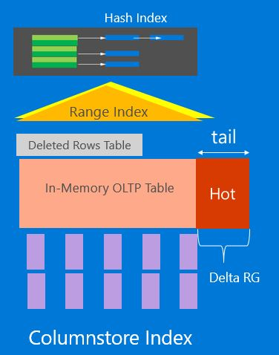
In-Memory OLTP & ColumnStore
Developers’s
Full support starting SQL Server 2016
How to use it
Create an index
alter table [in-memory-oltp-table] add index <index-name> clustered columnstore
May control how long a row will stay in tail, using compression delay option
Good to know
CCI index is persisted, but it is required to be fully resident in memory (approx. 10% more memory usage)
It cannot be a filtered index
Usage scenarios
HTAP
IoT
DBA’s
CCI is a special NCCI that includes all the columns from memory-optimized table (“double” the data)
New rows are inserted only in memory optimized table
The tail is tracked using a dedicated memory allocator
Rows are compressed into CCI once they reach the count of 1 million
Column / segment elimination (sys.column_store_segments)
Pushdown of aggregates and predicates
Batch mode execution: up to 900 records at once

Slide 5
Useful links
SQL Server In-Memory OLTP Internals Overview
https://msdn.microsoft.com/en-us/library/dn720242.aspx
Transactions with Memory-Optimized Tables
https://docs.microsoft.com/en-us/sql/relational-databases/in-memory-oltp/transactions-with-memory-optimized-tables
Merge Operation in Memory-Optimized Tables
https://blogs.technet.microsoft.com/dataplatforminsider/2014/01/22/merge-operation-in-memory-optimized-tables/
Transact-SQL Constructs Not Supported by In-Memory OLTP
https://docs.microsoft.com/en-us/sql/relational-databases/in-memory-oltp/transact-sql-constructs-not-supported-by-in-memory-oltp
Bob Ward’s – Inside SQL Server In-Memory OLTP
https://www.slideshare.net/BobWard28/inside-sql-server-inmemory-oltp-72339103
Overview of Columnstore Indexes in SQL Server
https://blogs.sentryone.com/melissacoates/overview-columnstore-indexes-sql-server/
Columnstore Index Performance: Rowgroup Elimination
https://blogs.msdn.microsoft.com/sql_server_team/columnstore-index-performance-rowgroup-elimination/

Slide 6
Q & A

