Slide 2
What is MemSQL
Magic Quadrant for Data Management Solutions for Analytics
A distributed, relational database HTAP capable:
Distributed scale-out
No buffer pool
Lock-free data structures
Code generation
Written in C++.
Developed by MemSQL Inc. based in San Francisco.
First public release on April 2013, now it has reached version 5.8.

Slide 3
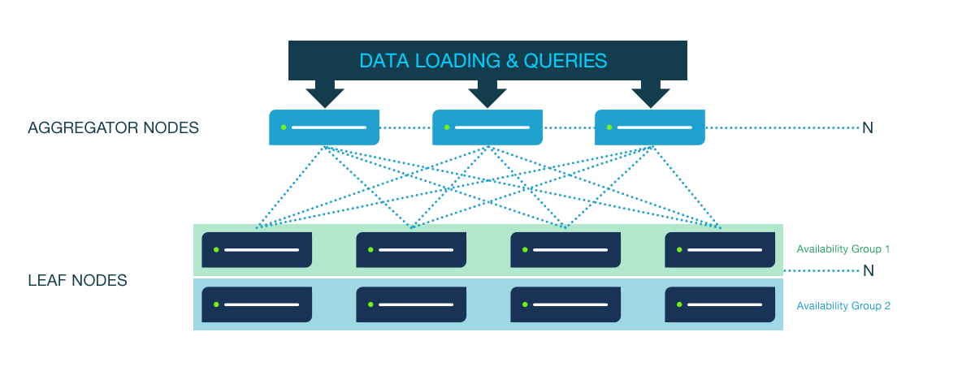
Scalable, two-tiered architecture
Aggregator nodes – receive SQL queries, break them up across leaf nodes and aggregate results back to the client.
Leaf nodes - store data and process queries from the aggregator.
There is a master aggregator through which DDLs get executed.
All communication over network is done through SQL syntax.
Supports high availability through availability groups.

Slide 4
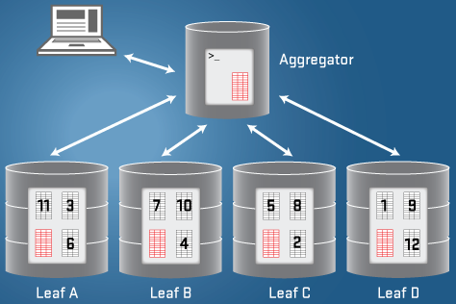
How data gets spread
Tables are either replicated or partitioned.
Uses hash partitioning for uniform distribution across leaf nodes.
Cluster can be dynamically scaled - it rebalances existing partitions only.
Supports joins between partitioned tables:
It can redistribute data
It can use collocated data
Replicated data is also distributed to aggregators.

Slide 5
In-Memory and On-Disk Storage
In-memory store
Implemented through lock-free hash tables and skip lists.
Best suited for fast random access - transactional workloads.
Durability is achieved with a write-ahead log and snapshots (transaction_buffer setting).
On-disk column store
Compressed and kept on disk only – large volume, real time analytics.
They are fronted by an in-memory rowstore-like structure (skip lists) for fast ingest capabilities.

Slide 6
Connect and interact
Is wire-compatible with MySQL - uses same clients and drivers, as well as standard ODBC and JDBC connectors.
Supports a subset of the MySQL syntax, plus extensions for Geospatial, JSON.
Does not have a procedural language.
It supports MVCC and fast, distributed "READ-COMMITTED" transactions; not suitable for "SERIALIZABLE" transactions.
SQL queries are striped of their parameters and compiled into machine code - overhead for first time execution.
Integration with Apache Spark and Kafka – streaming pipelines.

Slide 7
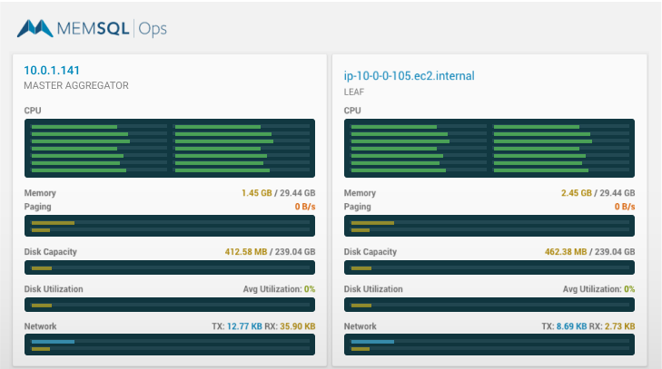
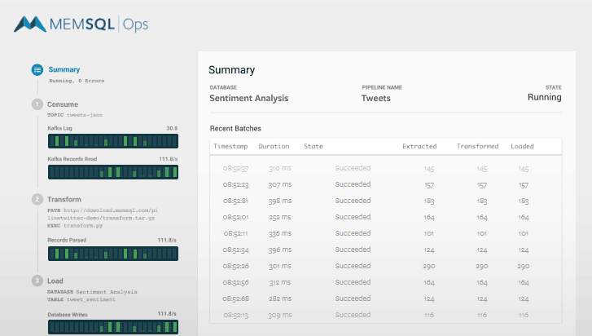
Administration and monitoring
Runs on linux.
MemSQL Ops provides a simple command line and web interface for installation and cluster deployment.
Can be deployed on-premise, AWS and Microsoft Azure.

Slide 8
Editions
MemSQL Community is free without limitations on capacity, cluster size, or time. All SQL features for development are included.
MemSQL Enterprise is licensed by subscription based on memory capacity. Adds production features like:
24x7 support
High Availability
Cluster Replication
Backups
Plans for a MemSQL Cloud offering.
Managed backups, updates and upgrades
24x7 monitoring
Hourly or annual subscription

