Slide 1
ORACLE in-MEMORY
Pure Columnar technology

Slide 2
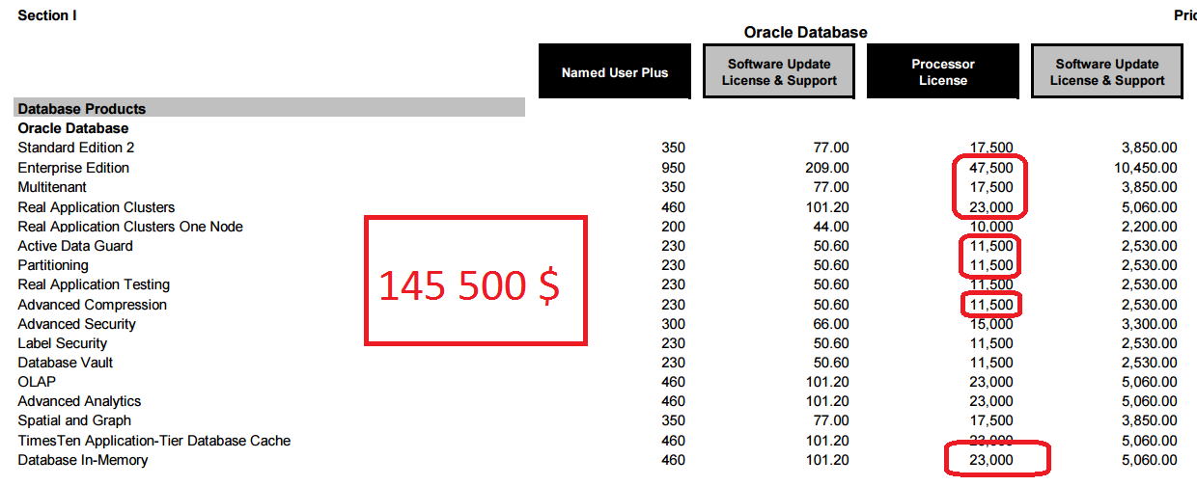
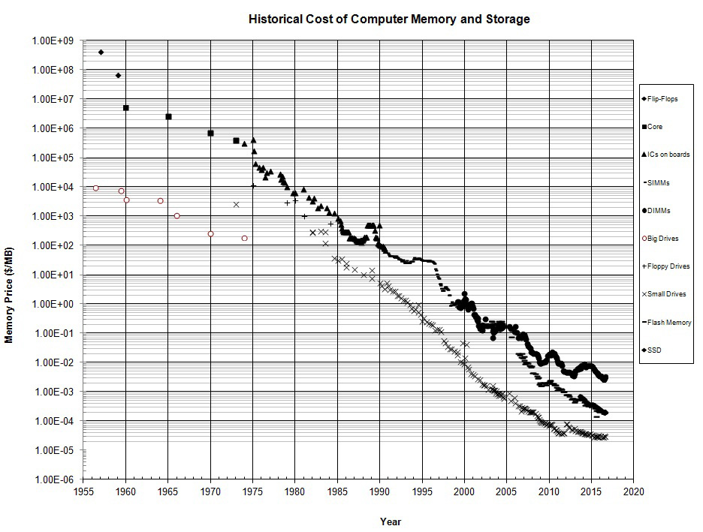
The necessity
100x Faster Queries: Real-Time Analytics
2x Faster Queries: OLTP & BATCH
SIMD (single instruction processing, multiple data ) vector processing and other HW features on Exadata
Competition – SAP HANA + some technologies presented by my colleagues
Performance needs
Mixed workload
HW evolution and memory cost
Annoying Competition

Slide 3
CHARACTERISTICS
SF features
BOTH row and column formats for same table
Pure in-memory format - never causes extra writes to disk.
Simultaneously active and transactional consistent
Accelerated Mixed workload*
No changes in the application required*
Different compression levels 2 – 20x
Integration with ADO, Optimizer, PX, RM, ADG and RAC
Attribute at tablespace, table, partition and column level
In-Memory population priority CRITICAL, HIGH, MEDIUM, LOW and NONE
In-Memory Fast-Start
In-Memory expressions
In-Memory Virtual columns
In-Memory JSON queries
Integration with Exadata (PCI-E Flash, Resiliency…)
In-Memory Hash Groups

Slide 4
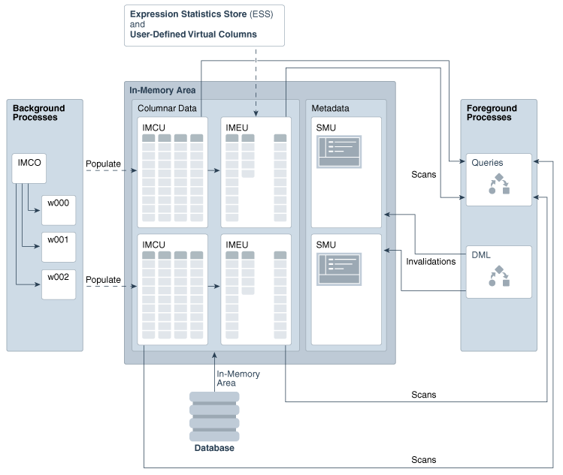
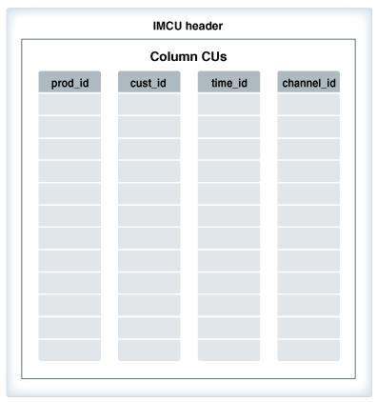
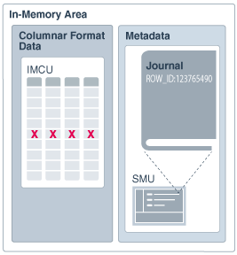
Behind the scene – quick look
From: Oracle Database In-Memory Guide, 12c Release 2 (12.2) - E71458-07

Slide 5
References
Oracle Database In-Memory with Database 12c Release 2
Oracle Database In-Memory
Database In-Memory Guide
Oracle Database In-Memory Aggregation Paper
When to use Oracle Database In-Memory

Slide 6
Q&A

