Slide 1
In Memory Databases
Ionuţ Hrubaru: ionut.hrubaru@gmail.com
Iaşi, 05.05.2017

Slide 2
An IMDBMS stores the database "in memory" and accesses all the data directly, without the use of input/output instructions to store and retrieve data from disks.
This should not be confused with a caching mechanism, which stores and manages disk blocks in a RAM cache for speed.
IMDBMSs are available in either "row-store" or "column-store" models, or a combination of both
Notes:
Exista o linie foarte blurry intre sistemele relationale clasice care au inceput sa adauge featururi in memory pentru produsele lor, featureri integrate in engine-ul de baze de date cum ar fi Oracle si MS SQL Server de care vom discutat astazi si noile baze de date In memory, produse noi care au fost oncepute, ca si arhitectura, design sa ruleze in principal doar in memorie, spre exemplu exasol sau memSQL. Dar spre simplificarea discutiei le vom numi pe ambele cateogrii in memory database. Ambele cateogrii ofera support ACID, support puternic SQL
Mergand mai departe, exista si conceptul de In Memory Data grids, care mai sunt numite In Memory NoSQL databases, in care se renunta la o parte din suportul ACID pentru alte criterri, cum ar fi performanta si care de obicei nu suporta SQL to the full
Ca sa adaugam si mai multa
OLTP si OLAP
HTAP –
In memory – either single or distributed with special structures

Slide 3
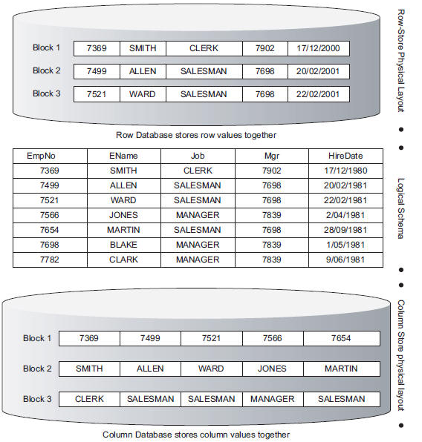
Notes:
Big Data se refera la volum, viteza si varietate, dar procesarea ridica problem serioase care presupun existent sistemelor distribuite
Sistem distribuite – se refera fie ca storage, fie ca procesare, fie prin HDFS fie prin Map Reduce. Dar Oracle RAC e doar la procesare, pt ca foloseste un SAN. Probleme distribuire: transcatii, 2 phase, CAP teorema, availability through replication
OLTP si OLAP
HTAP –
In memory – either single or distributed with special structures

Slide 4
Landscape
Classical relational databases (Oracle/MSSQL Server)
In Memory NewSQL (Exasol, MemSQL)
In memory data grids (Apache Ignite)
SQL + ACID
Tiered storage
Distributed (Exasol, MemSQL) vs monolith (Oracle,
In memory Rowstore (MemSQL), ColumnStore (Oracle), or both (SAP Hana)
OLTP (VoltDB) / OLAP (Exasol)
Notes:
Exista o linie foarte blurry intre sistemele relationale clasice care au inceput sa adauge featururi in memory pentru produsele lor, featureri integrate in engine-ul de baze de date cum ar fi Oracle si MS SQL Server de care vom discutat astazi si noile baze de date In memory, produse noi care au fost oncepute, ca si arhitectura, design sa ruleze in principal doar in memorie, spre exemplu exasol sau memSQL. Dar spre simplificarea discutiei le vom numi pe ambele cateogrii in memory database. Ambele cateogrii ofera support ACID, support puternic SQL
Mergand mai departe, exista si conceptul de In Memory Data grids, care mai sunt numite In Memory NoSQL databases, in care se renunta la o parte din suportul ACID pentru alte criterri, cum ar fi performanta si care de obicei nu suporta SQL to the full
Ca sa adaugam si mai multa
OLTP si OLAP
HTAP –
In memory – either single or distributed with special structures

Slide 5
Use cases
HTAP
Real time analytics
Planning apps
Iterative processing over a data set (ETL)
Notes:
Big Data se refera la volum, viteza si varietate, dar procesarea ridica problem serioase care presupun existent sistemelor distribuite
Sistem distribuite – se refera fie ca storage, fie ca procesare, fie prin HDFS fie prin Map Reduce. Dar Oracle RAC e doar la procesare, pt ca foloseste un SAN. Probleme distribuire: transcatii, 2 phase, CAP teorema, availability through replication
OLTP si OLAP
HTAP –
In memory – either single or distributed with special structures

Slide 6
Vendor | Primary use case
Aerospike | Operational
Altibase | Operational
Couchbase | Analytical/Operational
DataStax | Analytical/Operational
Exasol | Analytical
IBM | Analytical
Kognitio | Analytical
Kx Systems | Analytical
MemSQL | Operational/HTAP
Microsoft | Analytical/Operational/HTAP
Oracle | Analytical/Operational
ParStream | Analytical
Quartet FS | Analytical
Redis Labs | Operational
SAP | Analytical/Operational/HTAP
Teradata | Analytical
Unicom Systems | Operational
VoltDB | Operational/HTAP
Gartner
Market Guide for In-Memory DBMS
October 2015

