Slide 1
VoltDB

Slide 2
Thinking process
How faster operational stores can be?
Operational systems will be memory centric
Horizontal scale-out
But what are the OLTP bottlenecks?

Slide 3
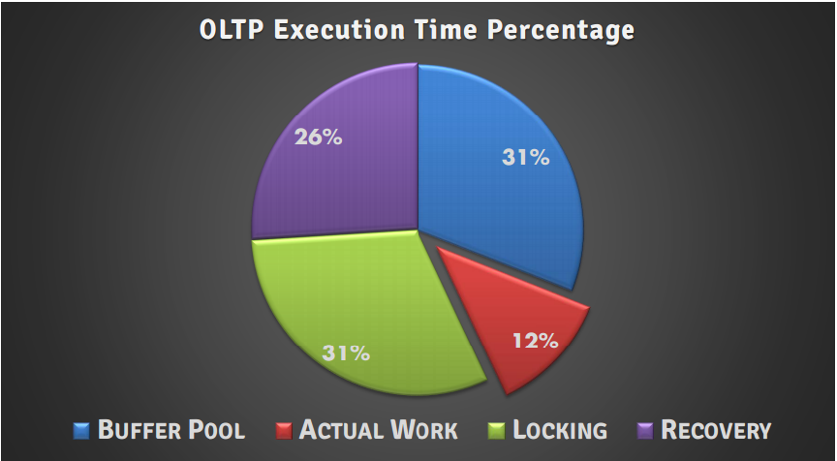
Thinking process

Slide 4
Architecture
One thread – one task at a time
No waiting on users
Concurrency through Scheduling, Not Shared Memory
Modern disk persistence
High Availability & Leveraging Determinism

Slide 5
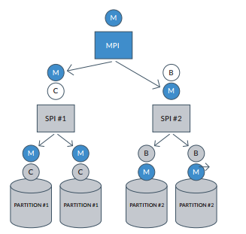
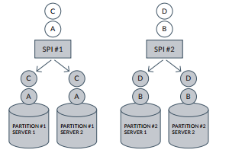
Transactions

